Slide 1


Slide 2
ASAP:
Achieving Satisfactory Academic Progress
At the end of this session you should be able to:
Understand how SAP affects Financial Aid Eligibility
Learn how to calculate your GPA
Make informed decisions
Start the SAP appeal process
Notes:
Briefly mention what session will cover

Slide 3
How SAP Affects
Financial Aid Eligibility
Grade Point Average (GPA)
Completion rates
Maximum Credits Attempted

Slide 4
Satisfactory Academic Progress (SAP)
To be eligible for federal and state student aid funds a
student must be making satisfactory academic progress.
Three criteria used for evaluating SAP:
1. Grade Point Average – GPA
2.0 or better GPA required
2. Completion Rate
    Must complete 67% of attempted credits
3. Maximum Credits Attempted – Maximum
Time Frame
150% of degree credits required for degree =
maximum of 180 credits
Notes:
Discuss the three criteria/measurements for evaluating SAP. If any of the three measures is not met, it will have an impact on your FA.
GPA – depending on how many credits student has, determines if needs 1.75 or 2.0
Completion Rate – Must complete 67% of attempted courses. More details on this on next few slides.
Max Credits Attempted – 150% of degree, to graduate need 120 credits, 150% of that is 180 credits.

Slide 5
Grade Point Average

Slide 6
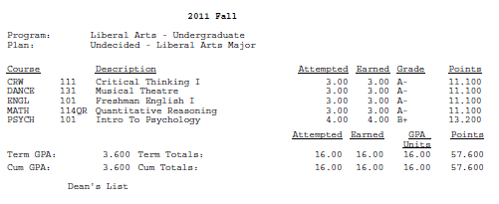
Where do I find my GPA?
JAGNET- Student Academic Record
DegreeWorks
Notes:
Ask students if they know their GPA and where to find it. Explain the difference between “semester” and “cumulative”.

Slide 7
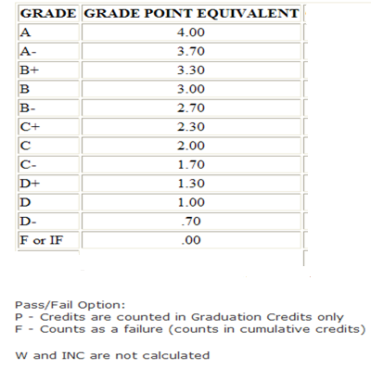
How is GPA calculated?
Notes:
Explain how every letter grade translates to a grade point equivalent. This is important because that’s how you figure out your GPA. Low grades (D’s & F’s), are not good for GPA. Explain where students can find the GPA Calculator, and possibly show them how to use it.

Slide 8
How is GPA calculated?
Multiply the grade points for each course by the number of credit hours each course is worth. The resulting value is referred to as “Quality Points”
Add together earned quality points for all courses completed in a semester
Divide the sum by the total number of completed semester credit hours
Credit Hours Grade (Equivalent) Quality Pts
3 x C- (1.7) = 5.1
3 x B- (2.7) = 8.1
3 x C- (1.7) = 5.1
3 x C- (1.7) = 5.1
TOTAL: 12 23.4
23.4 (Quality Pts) ÷ 12 (credit hrs) = 1.95 ← semester GPA
Notes:
Explain how GPA is calculated. Emphasize that these are all passing grades, but gpa is below 2.0, so just passing is not always enough. Explain how utilizing the pass/fail option is important in this case.

Slide 9
Academic Standing
Dean’s List/Honors
Good Standing
Warning
Suspension
3.2 +
2.0
Less than 2.0
Notes:
To gain a more clear understanding, please visit the link below for more information regarding academic standing:
http://www.umb.edu/registrar/academic_policies/academic_standing

Slide 10
Completion Rates
Successfully completed credits ÷ Attempted credits
You must complete, with passing grades, 67%
(two-thirds) of the total number of credits
you attempt. This includes non-degree coursework, and courses you might have taken at STC many years ago or during Dual- Enrollment within HS
Grades of F, W, INC, NA or PRG must be counted
as ‘attempts’
Transfer credits count as both attempted and earned.
Notes:
-Mention to students that transfer credits help towards completion. If students need further understanding of how the transfer credits work out toward the completion rate, you must refere them to FA office.
-Reiterate the 67% completion rate.
-Explain how F, W, INC, NA & PRG (PRG refers to CPCS competency based courses that are still in progress and no grades yet, are attempted courses but not completed. You have not earned credit for them while they are listed this way on your transcript/academic record. INC, if you complete coursework, may get switched to a letter grade. Work all INC’s out w/your professor.

Slide 11

How Completion Rates work
Anna’s First Semester
Subject | Catalog | Component | Official Grade | Units Taken | Course Name
MATH | 115 | Lecture | B+ | 3 | College Algebra
ENGL | 102 | Lecture | W | 3 | Freshman English II
PHIL | 108 | Lecture | A | 3 | Moral Social Probls
EEOS | 120 | Lecture | B | 3 | Intro to EEOS - Lect
EEOS | 121 | Laboratory | W | 1 | Intro to EEOS Lab
1. GPA = 3.433
2. Completion Rate = 9 ÷ 13 = 69%
3. Max. Credits Attempted = 13
SAP 1st Semester

Slide 12

Anna’s Second Semester
Subject | Catalog | Component | Official Grade | Units Taken | Course Name
ECON | 101 | Lecture | INC | 3 | Intro To Micro
ENGL | 102 | Lecture | W | 3 | Freshman English II
JAPAN | 102 | Lecture | NA | 4 | Intro Japanese II
PHIL | 110G | Lecture | W | 4 | Equality & Justice
1. GPA = 3.433
2. Completion Rate = 9 ÷ 27 = 33%
3. Max. Credits Attempted = 27
SAP 1st Year

Slide 13
Academic Standing and
Satisfactory Academic progress
Academic Standing
  Based only on your GPA
  Affects your academic status
Satisfactory Academic Progress (SAP)
  Based on GPA, Completion Rate & Maximum Credits Attempted
  Affects your financial aid eligibility status

Slide 14
Making Informed Decisions
-Grading/course options
Grading/Course Options
Resources
options
-Resources
-Resources

Slide 15
Failing Grade Options
Things to consider:
Talk to your instructor
Some majors/minors don’t allow: D or F Grades, Check!
Access STC student services for assistance: Library, CLE, Advising, Student Financial Services.
Notes:
Explain the importance of consulting with the instructor prior to declaring pass/fail.

Slide 16
Withdrawal
Course Withdrawal:
Withdrawal = “W” on transcript (not in GPA)
Things to consider:
Talk to your instructor
Talk to your advisor
3. May affect financial aid: CHECK!!!
4. Declare “W” via Admissions by deadline
Notes:
Explain the importance of consulting with the instructor prior to withdrawing.

Slide 17
“F” vs. “W”
“F” with Pass/Fail
With Withdrawal
ENGL 101: C
MATH115: C
PHIL108: F
PSYCH100: C
Semester GPA: 1.5
ENGL 101: C
MATH115: C
PHIL108: W
PSYCH100: C
Semester GPA: 2.0

Slide 18
Repeat Policy
Both the first and the second earned grades appear on transcripts
When student repeats a course, the first grade comes out of the GPA, and the second grade replaces the first
Credit is only earned once
Each repeat counts as an attempt for SAP
  Example: You failed English 101. This counts as 3 credits attempted, 0 credit completed. You repeat and pass English 101 the next term. SAP calculates this as 6 credits attempted, 3 completed.
  Financial aid will only cover a repeated course twice.

Slide 19
Tips for Maintaining SAP
See your Academic Advisor regularly
Review your Jagnet/DegreeWorks as frequently as you can
Focus on your degree/graduation requirements by taking only courses that pertain to your degree while also completing your general electives
Educate yourself on SAP criteria by regularly visiting the Financial Aid Services web page on the STC website and by Visiting our Office.

Slide 20
Satisfactory Academic Progress Appeal Process
Request SAP Appeal from STC Financial Aid Office
Have appeal signed by academic advisor or Counselor
Submit the SAP Appeal
Take the next steps

Slide 21
Appeal Process
Check your Jagnet account for information regarding your Financial Aid SAP Appeal Status
    *Students don’t have to be full-time.
Follow up questions, contact: Office of Student Financial Services

Slide 22
Next Steps
  Financial Aid Appeals committee will notify you of their decision within 14 business days of receipt of completed appeal
    Appeals which are approved will be on a probationary basis and will be reviewed after one semester- * At the end of the semester, the Financial Aid Office will review your progress and verify if you followed the ag. Failure to adhere to your plan may result in loss of financial aid eligibility
    If your appeal is DENIED, you will not be eligible to receive Financial Aid until you meet the requirements of Satisfactory Academic Progress
    Have a back up plan for tuition payment in case you are denied financial aid. Consider setting up a payment plan with the Cashiers Office
Notes:
Review slide. Also reiterate that, there are many forms of aid that are not available to students who are packaged late (for example, work study). Students who are approved for SAP will be awarded aid based on available funds so completing the process in a timely manner is crucial. If DENIED, will not be eligible for aid again until student meets the requirements of SAP.

Slide 23

  Stay on Track
  Have a Great Academic Semester
  Let us know how we can help you

Slide 24
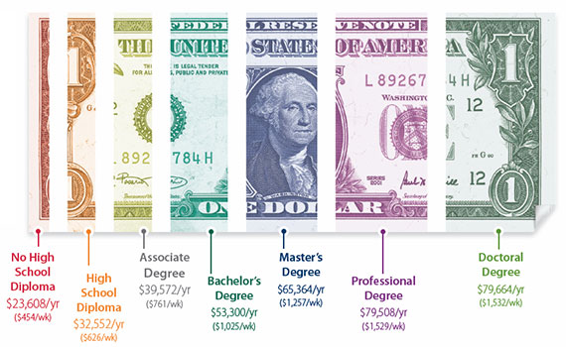
Remember! Learn More, Earn More
$19,000
No High
School
Diploma
$40,000
Associate
Degree
$60,000
Master’s
Degree
$86,000
Professional
Degree
$26,000
High
School
Diploma
$50,000
Bachelor’s
Degree
$80,000
Doctoral
Degree
Retrieved from www.AIE.org – 2010 Texas Median Wages by Degree Level
Source US Census Bureau Community Survey 2010

Slide 25
Thank You…

Slide 26




Contact Information
www.southtexascollege.edu/finaid
South Texas College- Pecan
3201 West Pecan Blvd
Student Services Building K 1.700
McAllen, Texas 78501
Phone: (956) 872-8375
South Texas College- Mid-Valley
400 North Border
Student Services Building F 121
Weslaco, Texas 78596
Phone: (956) 447-6672
South Texas College- Starr
142 FM 3167
Student Services Building G 1.410
Rio Grande City, Texas 78582
Phone: (956) 488-5803
Phone: (956) 488-5859
South Texas College- Technology
3700 West Military Hwy.
W Building Student Services Area Room 176
McAllen, Texas 78501
Phone: (956) 872-2728
South Texas College- Nursing & Allied Health
1101 East Vermont
Student Services Area Room 1.406
McAllen Texas 78503
Phone: (956) 872-3019
facebook.com/SouthTexasCollegeFinAid
@STCFinancialAid
STC Student Financial Services

